Slide 1

HR Analyst Dashboard
Insights into Employee Attrition, Diversity, Tenure, and Compensation

Slide 2
Objective of the Dashboard:
Analyze HR metrics like attrition, tenure, diversity, and salary trends.
Provide actionable insights for decision-making.
Key Features:
Interactive charts.
KPI cards for high-level insights.

Slide 3
Dashboard Chart Explanations
Attrition Count & Rate
Attrition Count: Displays the total number of employees who left the organization (237).
Attrition Rate: Highlights the percentage of total employee turnover (16.12%).
2. Years at Company
Shows the cumulative years spent by employees in the organization (37 years).
3. Employee Count & Active Employees
Employee Count: Total workforce (1,470 employees).
Active Employees: Number of currently employed staff (1,233 employees).
4. Average Age
Indicates the average age of the workforce (36.92 years).

Slide 4
explanations
5. Education Field-Wise Attrition
Bar chart showing attrition distribution across education fields, with Life Sciences (89) and Medical (63) having the highest attrition.
6. Gender Diversity in Attrition
Pie chart showing gender-based attrition: 150 females and 87 males.
7. Job Satisfaction Rating by Role
Bar chart showcasing job satisfaction ratings by role, with Research Scientists (292) and Laboratory Technicians (259) having high satisfaction.
8. Attrition Rate by Gender Across Age Groups
Pie charts showing attrition rates for males and females in different age groups. The 25-34 age group has the highest attrition rate (29.11%).
9. Number of Employees by Age Group
Bar chart representing employee count by age group, with the 31-36 age range having the highest number (274 employees).

Slide 5
KPIs Overview
KPIs included in the dashboard:
ATTRITION COUNT
YEARS AT COMPANY
ATTRITION RATE
ACTIVE EMPLOYEES
AVERAGE AGE
EMPLOYEE COUNT

Slide 6
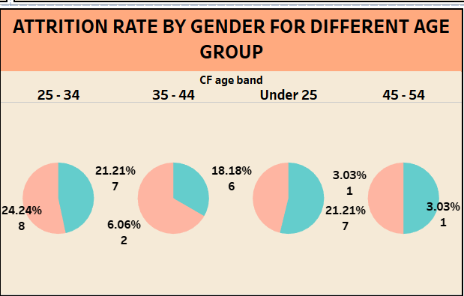
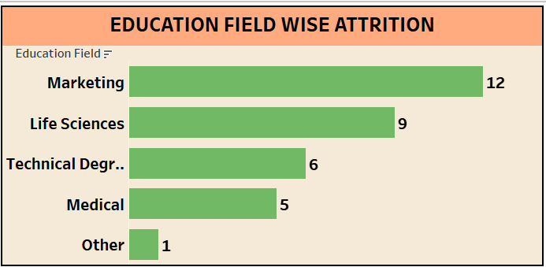
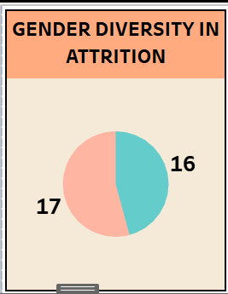
Key Visualizations

Slide 7
CONCLUSION
The HR Analytics Dashboard provides actionable insights into workforce metrics such as attrition rates, employee Count, and demographics.
Key performance indicators (KPIs) highlight critical trends in employee count, Attrition Rate and workforce diversity.
Visuals like bar charts, line graphs, and pie charts simplify complex data and enable better decision-making for HR strategies.
These insights can help the organization identify areas for improvement, optimize resource allocation, and enhance employee engagement.
The dashboard ensures data-driven decision-making to align HR strategies with organizational goals effectively.

